Slide 1
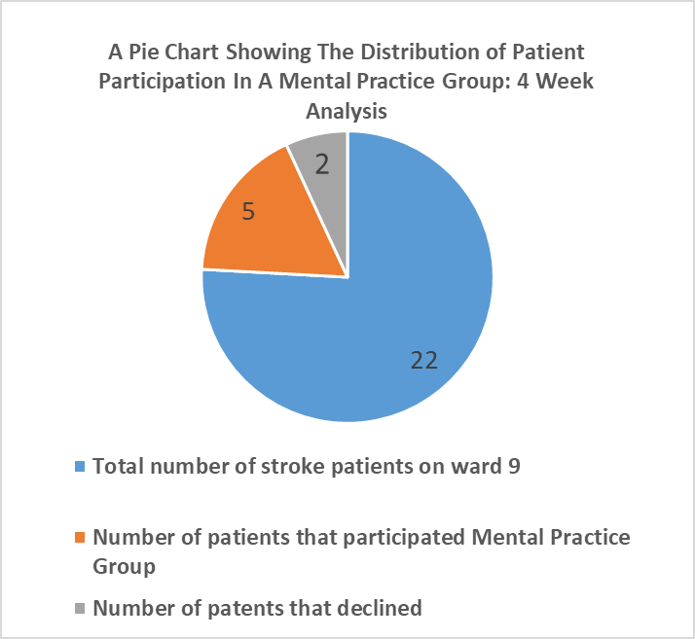
B5 Project by Sacha Butterworth
Setting up a Mental Practice Group on Ward 9 Stroke Rehabilitation
Introduction
Mental Practice (MP) is a key intervention in evidence-based guidelines for upper limb rehabilitation after stroke (Rudd et al., 2017).
MP involves repeated cognitive rehearsal or motor imagery without physical execution (Barclay et al, 2020). Research shows that MP activates many of the same brain areas stimulated during actual movement (Braun et al., 2017).
It's particularly valuable for patients with no voluntary movement, while also benefiting those with good function in refining high-level skills (Moran et al., 2012).
It is beneficial in acute and chronic stages (Stockley et al, 2021).
The updated National Clinical Guidelines for Stroke recommend that patients receive 3 hours of therapy daily, at least 5 days a week (Stroke National Guidelines, 2023). Currently, Ward 9 is unable to meet this target due to staffing constraints. Implementing MP can help bridge this gap, as it requires minimal equipment and allows for self-directed practice.
By incorporating a mental practice group, we can increase therapy time, providing patients with an effective, accessible rehabilitation method that complements physical therapy.
Method
Conducted training on MP for Ward 9 therapy team and gathered initial feedback.
Created a MP proforma, including prompts for developing individualised MP scripts for patients, families, and staff.
Identified suitable patients for the MP group based on established criteria
Administered the Kinaesthetic and Visual Imagery Questionnaire (KVIQ-10) (Malouin et al., 2007) to screen for motor imagery ability and assessed patient adherence to instructions.
Conducted 45-minute MP group sessions with selected patients.
Re-administered KVIQ-10 to reassess imagery ability.
Recorded patient satisfaction with the session.
Designed and presented a poster to Ward 9 therapy team
Collected feedback on the project outcomes and implementation
Results
Over a four-week period, 5 patients attended the MP Group.
Identified barriers to participation: cognitive impairments, dysphasia, confusion, medical instability, patient adherence issues, staffs uncertainty regarding patients' ability to concentrate.
Findings indicate a need for enhanced staff education on inclusion criteria to improve patient selection.
Patient’s KVIQ-10 results were recorded for each session.
Participants reported positive experiences with the sessions.
The MP group successfully increased weekly therapy time for participating patients.
Results highlight the importance of refining patient selection process and addressing identified barriers to maximize the effectiveness of the MP intervention.
Limitations and Future Considerations
Limited sample size due to patient adherence issues and the prevalence of cognitive deficits in the stroke population.
Future research could focus on refining and educating staff about inclusion criteria, particularly regarding cognitive impairment thresholds.
Time constraints and staffing shortages restricted opportunities to thoroughly educate rehabilitation staff on MP.
Difficulty in monitoring progress of MP alone on upper limb function, making it challenging to assess individual patient effectiveness.
The project's short duration necessitates further auditing and feedback for comprehensive evaluation.
Continuing the project to allow for more extensive education of rehabilitation assistants, enabling them to confidently deliver sessions.
Implementing a patient feedback questionnaire to identify areas of success and potential improvements.
Reviewing and potentially adjusting inclusion criteria, coupled with staff education to ensure appropriate patient selection.
Conclusion
The MP group has been beneficial in increasing patient therapy time and enabling self-directed practice. Moderate to high-quality trials indicate that MP can significantly reduce upper limb activity limitations (Stockley et al., 2021). The combination evidence-based efficacy, positive patient experiences and alignment with the trust's core value of innovation, suggests that a MP Group could become a valuable, integral component of patients rehabilitation on ward 9, therefore I hope this project can continue.
Aims and Objectives
To implement a weekly Mental Practice Group on ward 9.
To improve upper limb function in stroke patients.
Increase weekly therapy time for patients on ward 9 inline with Stroke guidelines.
Increase self practice on the ward.
Participants
Participants included in this project were current inpatients on ward 9 freeman stroke who had deficits in upper extremity activity with no significant cognitive impairment.

Slide 2
References
Barclay, R.E., Stevenson, T.J., Poluha, W., Semenko, B. and Schubert, J., (2020). ‘Mental practice for treating upper extremity deficits in individuals with hemiparesis after stroke’, Cochrane Database of Systematic Reviews.
Braun, N., Kranczioch, C., Liepert, J., Dettmers, C., Zich, C., Büsching, I. and Debener, S., (2017). ‘Motor imagery impairment in postacute stroke patients’. Neural plasticity.
Hebert D, Lindsay MP, McIntyre A, (2016).’Canadian stroke best practice recommendations: Stroke rehabilitation practice guidelines,. Int J Stroke
Liu, H., Song, L., and Zhang, T. (2014). Changes in brain activation in stroke patients after mental practice and physical exercise: a functional MRI study. Neural Regen.
Malouin, F., Richards, C. L., Durand, A., and Doyon, J. (2008). ‘Clinical assessment of motor imagery after stroke. Neurorehabil’. Neural Repair.
Malouin, F., Richards, C., Jackson, P., Lafleur, M., Durand, A., and Doyon, J. (2007), ‘The kinesthetic and visual imagery questionnaire (KVIQ) for assessing motor imagery in persons with physical disabilities: a reliability and construct validity study. J. Neurol. Phys. Ther.
Moran A, Guillot A, MacIntyre T, Collet C. (2012) ‘Re-imagining motor imagery: building bridges between cognitive neuroscience and sport psychology. Br J Psychol.Page, S., and Peters, H. (2014). Mental practice: applying motor PRACTICE and neuroplasticity principles to increase upper extremity function. Stroke.
Randhawa, B., Harris, S., and Boyd, L. (2010). The kinesthetic and visual imagery questionnaire is a reliable tool for individuals with Parkinson disease. J. Neurol. Phys. Ther.
Rudd, A.G., Bowen, A., Young, G.R. and James, M.A. (2017). The latest national clinical guideline for stroke. Clinical medicine.
Stockley, R.C., Jarvis, K., Boland, P. and Clegg, A.J. (2021). ‘Systematic review and meta-analysis of the effectiveness of mental practice for the upper limb after stroke: Imagined or real benefit?’. Archives of Physical Medicine and Rehabilitation.

