Slide 1
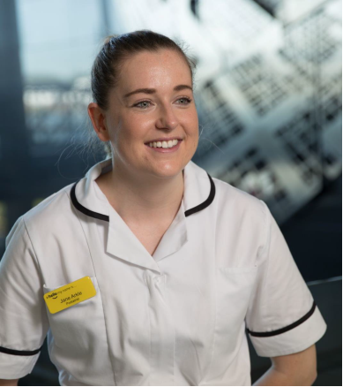
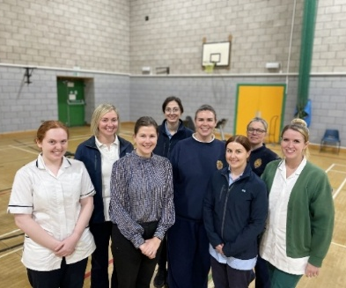
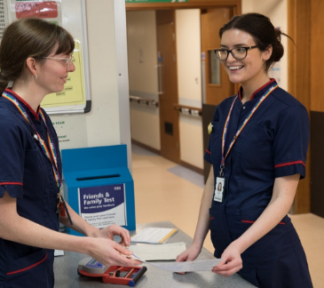
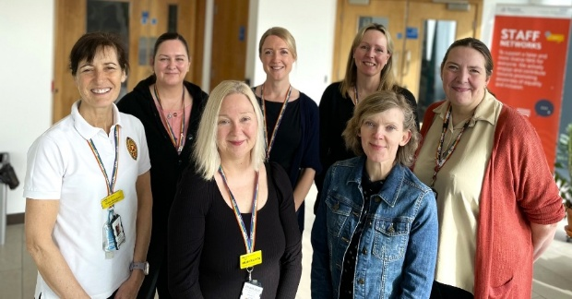
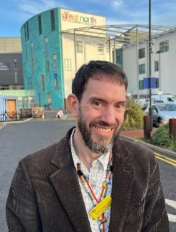
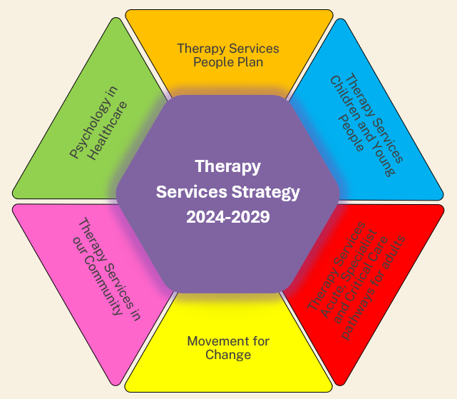
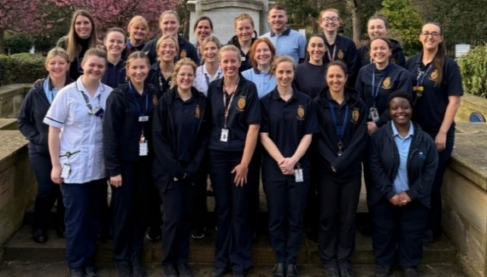
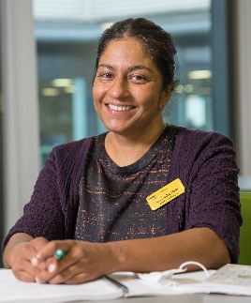
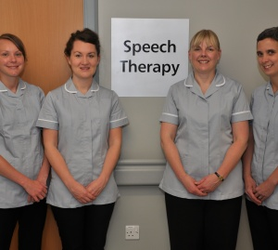
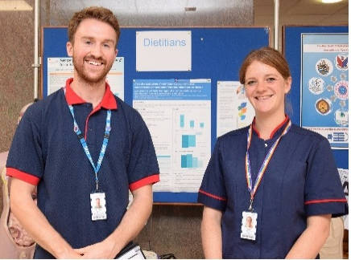
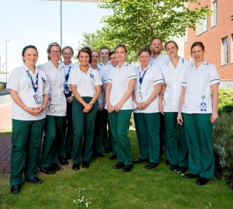
Therapy Services Directorate is a clinical directorate that sits as part of the Clinical and Diagnostic Services Clinical Board. The Directorate has approximately 850 staff, across 6 professional departments including Nutrition & Dietetics, Occupational Therapy, Physiotherapy, Podiatry, Psychology in Healthcare and Speech & Language Therapy working with children, young people and adults across hospital, out-patient and community settings.
The Directorate are supported by a team of admin professionals and includes a range of specialist services including Major Trauma Rehab, Community Stroke Services, Amputee Rehab, Loan Equipment, Wheelchair Services, Moving and Handling, Adult Specialist Weight Management, Chronic Fatigue, Post-Covid Rehab service, Primary Care Psychology and Tyneside Integrated Musculo-skeletal Services (TIMS).

Slide 2
Therapy Services Strategy 2024-2029
Our Purpose (Our Why)
Core Principles (Our Behaviours)
To provide timely, proactive and preventative therapeutic pathways that promote recovery, rehabilitation and self-management in a psychologically informed care system that improve quality, patient outcomes and experience.
Listen, engage, involve and effectively communicate with our staff
Strengthen clinical and professional leadership for AHP, Therapy and Psychology clinicians and teams
Commit to delivering safe, high quality and trauma informed patient care
Enhance our collective voice by working collaboratively on shared priorities
Work together with our MDT colleagues to actively contribute to Clinical Boards and Trust priorities
Embed sustainability into how we work and develop our services
Our Mission (Our What)
We provide high quality, compassionate and trauma-informed psychological and therapeutic services to all who need them across the patient lifespan.
Strategic Themes (Our Priorities)
Our Vision (Where we want to be)
To develop the quality, capacity and capability of our Therapy, AHP & Psychology staff and services working with children, young people, adults and older adults across our hospitals, local communities and regionally.

Slide 3
Therapy Services Strategic Priorities
Therapy Services People Plan
To provide a positive, supportive and healthy workplace for our Therapy Services team members where they feel listened to, empowered and valued
Psychology in Healthcare
To lead the provision of psychologically safe and trauma informed care across the organisation and beyond
Therapy Services Children and Young People
Providing excellent specialist services to meet the needs of the children, young people, their families and carer networks
Therapy Services in our Community
Developing and delivering collaborative specialist, proactive and preventative pathways across care settings and in our communities
Therapy Services Acute, Specialist and Critical Care pathways for Adults
Working collaboratively to deliver timely access to high quality, safe and sustainable specialist care, ensuring equitable and accessible provision of care for all
Movement for Change
Improving our populations' health and care outcomes through enhanced rehabilitation, recovery and reconditioning pathways and by supporting people across the life course to participate in meaningful physical activity and live well

Slide 4
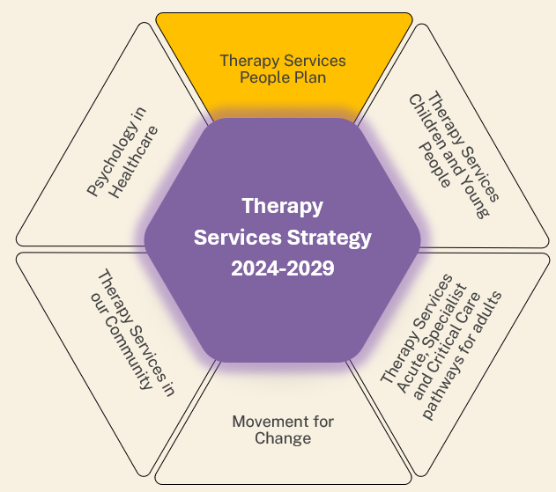
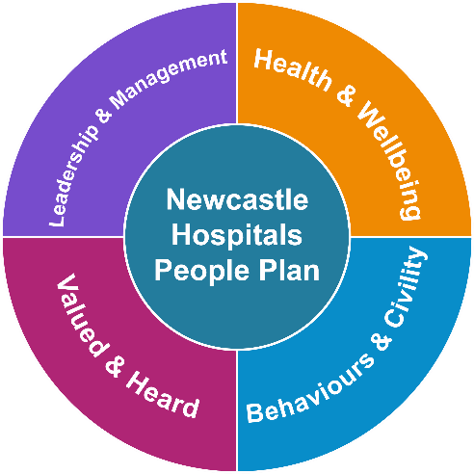
Therapy Services People Plan
To provide a positive, supportive and healthy workplace for our Therapy Services team members where they feel listened to, empowered and valued
The Therapy Services People Plan is aligned to the Trust People Plan which is centered around four themes of Health and Wellbeing, Behaviours and Civility, Valued and Heard, Leadership and Management.
Aims:
To ensure all our staff feel valued, heard, included and empowered to raise concerns and speak up
To ensure we provide a supportive workplace that promotes standardised and equitable health and wellbeing support for all who wish to access it
To embed clear standards of acceptable and appropriate behaviour and civility towards each other
To ensure all services have a detailed workforce, education and development plan to expand the knowledge and expertise of our team through shared opportunities, learning and collaboration
To strengthen links with education, academic and research partners to prioritise a range of initiatives to improve both recruitment & retention and the development of career pathways for all members of the workforce
To promote effective, efficient and sustainable services by encouraging all staff to consider new ways to deliver services, supported by job plans to understand demand and capacity

Slide 5
What is our aspiration?
For all staff within Therapy Services to feel empowered to speak up, listen up and act on feedback
We aim to provide a positive and healthy workplace where staff feel happy, valued and supported
For all staff within Therapy Services to have opportunities to learn and develop within their individual career pathways
What do we want to work on?
Strengthen the links between the trust People Plan and Therapy Services
Improving collaboration and communication between teams across Therapy Services
Provide clear, transparent and equitable opportunities for personal and professional development
To embed principles of equity in our practices including recruitment, appraisal, supervision and training
Working together through defined opportunities for reporting and sharing
Who is involved and who are the stakeholders?
Whole workforce – including learners, trainees, students and volunteers
Integrate ongoing development as part of Therapy Services Strategy group
What will tell us if we are making progress?
Targeted workforce engagement and feedback
Staff survey – sustained improvement in response to the staff survey year on year
Improved workforce data - sickness, retention and turnover
Increased Therapy Services profile (regionally/nationally/internationally)
Development/training/leadership opportunities taken up by Therapy Services staff
Visible diversity across our services that reflects our local population

Slide 6
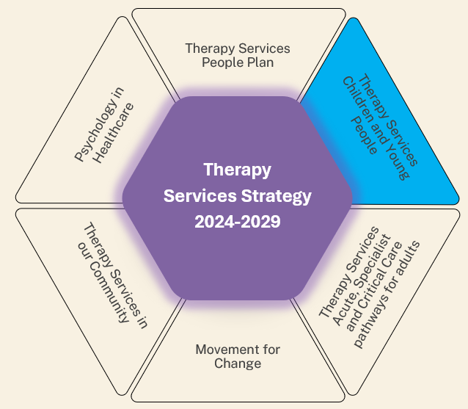
Therapy Services with Children and Young People:
Providing excellent specialist services to meet the needs of the children, young people, their families and carer networks
Aims:
To work collaboratively to support the reshaping and development of GNCH
To develop and expand capacity in PICU and priority specialty pathways
To develop a Paediatric Major Trauma Rehabilitation service
To support the “Movement for Change” ambition to: Improve health & wellbeing for children and young people by promoting and increasing meaningful, developmentally-appropriate activity in hospital and at home
To develop, expand capacity and enhance the community element of children’s therapy services supporting special education needs and explore options for hospital avoidance and quicker discharge i.e. intermediate, step-down models
To focus on how children and young people are supported across all transition points
To contribute to the development of services that support children and young people who are autistic, with neuro-diversity, learning disabilities and mental health
To work with education providers to support children and young people in their education settings

Slide 7
What is our aspiration
To address the recognised gap in resources and work towards creating more therapy and psychological support for children and young people
For all children and young people to develop and thrive to the best of their potential
For all children and young people to make maximum recovery from illness and injury
To work with partners in the care of children and young people seamlessly with common aspiration
To promote healthy behaviours, healthy environments and reduce health inequalities both within services and the wider community
What do we want to work on?
Enhance / strengthen and make more transparent opportunities for income generation
Work with business and HR to develop supported models of services bought in by schools and other NHS Trusts
Help nurture expertise in the region
Who is involved and who are the stakeholders?
Therapy Services Paeds Development Group
GNCH and Paediatric Cardio Directorate teams
Community partners in Family Health Board and NCC Local authority
Strengthen our relationship with the Great North Healthcare Alliance
What will tell us if we are making progress?
Increased service and staffing capacity
Optimisation and effective use of skills
Reducing bed days
Reducing follow-up clinic appts
Patient / parent experience
Reduce waiting times

Slide 8
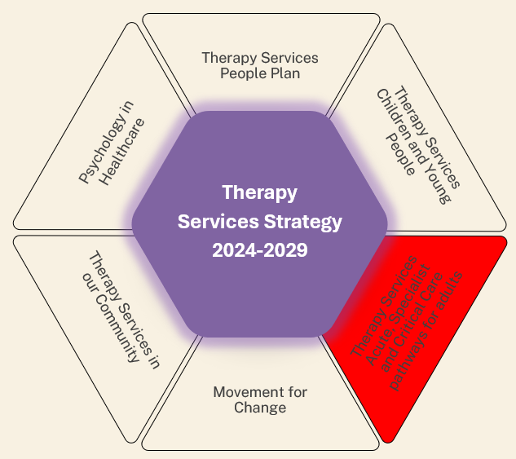
Therapy Services Acute, Specialist and Critical Care pathways for Adults
Working collaboratively to deliver timely access to high quality, safe and sustainable specialist care, ensuring equitable and accessible provision of care for all
Aims:
To develop and expand our capacity in Acute, Specialist and Critical Care settings so that our skilled workforce can provide quality care and improved outcomes
To support the “Movement for Change” ambition to: Improve and expand our emergency, urgent care and specialist hospital pathways so that our skilled workforce can provide quality care and improve outcomes through personalised prehab and rehab interventions
To improve and expand our emergency and urgent care pathways so that our skilled workforce can continually improve care and patient experience through personalised rehabilitation
To work together with partners in the system to ensure joined up and coordinated care, supporting discharge and safe step down/transition from services

Slide 9
Our aspiration
We aim to work with key partners across the system to explore and deliver innovative working models for optimum service delivery
We intend to use population health management approaches to move towards greater prevention and proactive care models
We want to work on?
Understanding the current demands for each of the services
The development of clear and robust service specifications with appropriate staffing
Embedding quality improvement at all levels
Developing true multi profession working and collaboration
Supporting optimal discharge planning, that promotes prompt access to therapy, to facilitate early supported discharge
Who is involved and who are the stakeholders?
Therapy Services workforce
Staff working across all Clinical Boards
Strengthen relationship with Great North Healthcare Alliance
What will tell us if we are making progress?
Measurably increased capacity
Improved patient outcomes
Reducing bed days
Patient experience
Reduce waiting times
Safe, timely discharge
Access to the right care, at the right time, with connected teams and information

Slide 10
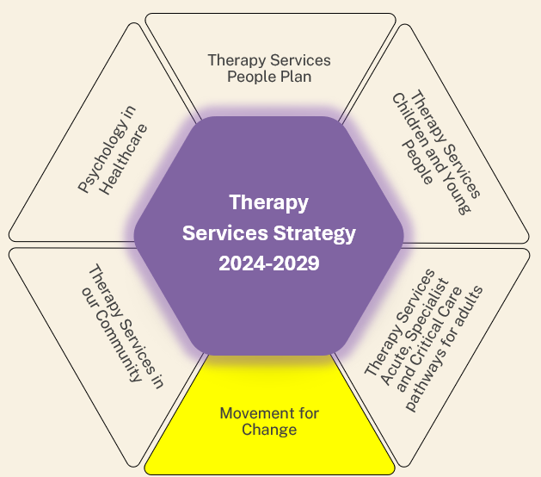
"Movement for Change" :
Improving our populations' health and care outcomes through enhanced rehabilitation, recovery and reconditioning pathways and by supporting people across the life course to participate in meaningful physical activity and live well.
Aims:
To improve health & wellbeing for children, young people, adults and older people by promoting and increasing meaningful, accessible and relevant physical activity in hospital and at home
To improve and expand our planned surgical and hospital pathways so that our skilled workforce can provide quality care and improve outcomes through personalised prehab and rehab interventions
To improve and expand our emergency and urgent care pathways so that our skilled workforce can continually improve care and outcomes through personalised rehabilitation.
To improve and expand our community, long-term conditions, frailty, falls, cancer and palliative care pathways so that our skilled workforce can provide quality care and improve outcomes through personalised rehabilitation
To embed education for staff within Therapy Services to promote physical activity champions conversations with patients as part of routine care
To provide education to promote physical activity as a way of preventing ill health / improving health across Newcastle

Slide 11
Our aspiration
We aim to improve the health and care of our local population by targeting physical inactivity both in and out of the hospital
We intend to enhance the profile of physical activity as a tool to improve health and longevity by increasing knowledge within our workforce
We intend to enhance the range of physical activity options available to patients across the Trust and encourage engagement with meaningful PA regardless of age or condition
We intend to support the education and practice development of staff to deliver frailty-aware care and falls
We want to work on
Understanding what the current prehab, rehab and physical offer is currently for children, young people, adults and older people across community and hospital services in the Trust’; to help us develop appropriate care pathways
We want to offer Physical Activity Champion (PAC) training to all staff across Therapy Services
Improving staff awareness and recognition of frailty, sarcopenia and falls risk and therapy interventions to support ageing and living well
Better understand the rehab needs within current service caseloads; this will help inform capacity and pathway development
Who is involved and who are the stakeholders?
Therapy Services staff
Staff from across all clinical boards
Social prescribers
North East Physical Activity Partnership (RISE)
Community Partners (e.g. Healthworks, GLL)
Newcastle United Foundation
National PAC team
Newcastle City Council
Newcastle Hospitals Charity
Regional Frailty partners
What will tell us if we are making progress?
Increased number of staff trained in physical activity conversations (PAC)
A Physical Activity Champions network for the Trust and with other stakeholders
Expansion of interventions / services targeting PA both in and out of hospital
Clearly mapped out structure of current and potential PA provision across Newcastle
Increased numbers of staff trained in Delivering Frailty-Aware Care
Improved documentation of frailty/sarcopenia/falls risk in EPR

Slide 12
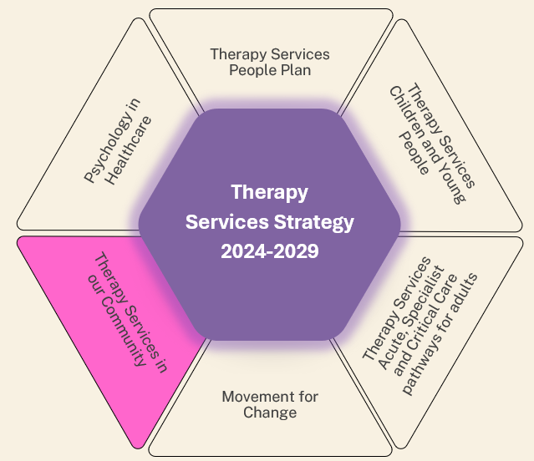
Therapy Services in our Community:
Developing and delivering collaborative specialist, proactive and preventative pathways across care settings and in our communities
Aims:
To work in partnership with Clinical Boards, Social Care, Primary Care and 3rd sector stakeholders to develop and deliver services together in local communities
To develop and expand capacity in our specialist pathways including Frailty and Cancer pathways so that our skilled workforce can provide optimum care
To develop and expand proactive and preventative community-delivered services
To support the “Movement for Change” ambition to: Improve and expand our community, long-term conditions, falls, frailty & sarcopenia, cancer and palliative care rehab skilled workforce to provide quality care and improve outcomes

Slide 13
Our aspiration
We want to work on
To seek opportunities to work collaboratively both within Therapies, and with partners across health and social care, to deliver high quality services in the community which optimise health outcomes
To identify health inequalities and address variation in access to Therapies and PiH
To promote physical and psychological well-being for patients through health promotion and self management practices.
Parity of physical and mental health care for all patients
Improving the integration of staff and pathways which span community services; taking a collaborative, pro- active approach to supporting those with long term conditions out of hospital
Improving the use of Data and digital technology to deliver services and to capture outcomes
Improving high- quality clinical skills which support first contact practice and trauma informed care
Expand and standardise a universal offer of care to prevent ill health and encourage self management
Multi professional task and finish groups to have oversight of pathways, ensuring collaboration , and understanding of gaps and overlap
Who is involved and who are the stakeholders?
What will tell us if we are making progress?
Engage with commissioners/ICB to agree community specifications which provide the capacity and capability to deliver high quality Therapy services
To increase engagement with Patient / service user groups
To collaborate with all clinical boards, Social services, community partners and Primary care staff
To embed patient reported outcome measures, and patient experience tools into community pathways, and enable ongoing evaluation
To review inappropriate and avoidable admissions/ referrals to secondary care as part of pathway evaluation
Reduction of health inequalities to be measured by access to pathways and services

Slide 14
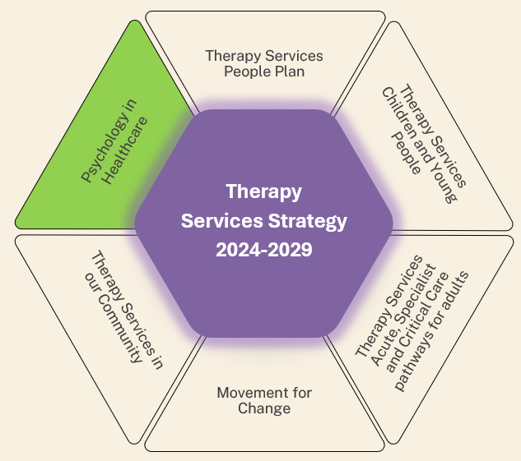
Psychology in Healthcare
To lead the provision of psychologically safe and trauma informed care across the organisation and beyond
Aims:
To provide high quality, inclusive, timely evidence-informed psychological care across the organisation and beyond, so that patients, their families, caring networks and our staff can thrive
To evolve our service by developing practice models and utilising technology to aid effective use of resources
To celebrate our achievements and strengthen our workforce through succession planning and professional development
To contribute towards growing the future generation of psychological professionals and trauma-informed practices across the trust and beyond
To develop and produce theory, practice and research in the field of Psychology in Healthcare and lead the field in co-producing services for marginalised and underserved patient groups

Slide 15
Our aspiration
We want to work on
Start intervention sooner, grow resilience from the start
Reduce health and service inequalities, increase workforce diversity
Use technological advances / better IT systems that reflect / manage what we do
Gap analysis clarity – work to get gaps get filled
Provide an equitable psychological offer to staff and patients
Co-design and co-production to be a fundamental principle of all service development and delivery
Operationalise stepped care models of service delivery
Build psychologically safe, trauma-informed collaborative MDT approaches across the trust and beyond, so reducing systemic distress / moral injury for staff and patients
Develop digital models of care / better utilisation of space
Co-producing services for marginalized and underserved patient groups
Provide recommendations for a trust-wide psychological support service
Who is involved and who are the stakeholders?
What will tell us if we are making progress?
Psychology in Healthcare system partners
Mental Health service providers
NHSE
All NUTH staff – psychologically safe and trauma-informed care is everyone’s business
Improvement of measures of well-being for patients and staff
Improved patient experience and outcomes
Improved staff retention and individual growth
Better balance of time for the range of psychological tasks

