Slide 1
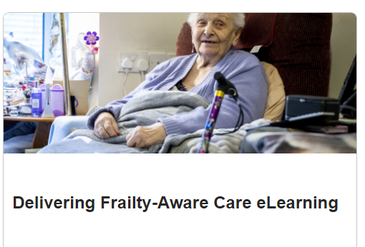
Strategy in Action Meeting Highlights (25.09.24)
Ewan Dick welcomed everyone to the September “Strategy in Action” meeting and opened by reflecting on the previous meeting and discussion with Karen Taylor about sustainability and where we heard an Active Hospitals progress update from Cath Turner and Kate Hallsworth.
Ewan introduced Charlotte Buckland and Emily Gilberg for their update on delivering the Frailty e-learning course. The aim of the course is to support all healthcare staff with their understanding of frailty using a consistent and sustainable educational approach.
Refreshing Therapy Services future strategy
The focus of the final part of the meeting turned to future Therapy Services strategy, how we develop our priorities and how this support and align with how the Trust is developing over the coming months and years.
1000 staff have completed the course so far and it has evaluated positively. Next steps are continued local cascade, exploring commercial potential and that the course will be included as part of the Training needs analysis/Training matrix - Heads of Service encourage all adult services staff to complete the frailty training. The course is accessible via the learning lab, by following this link: Delivering Frailty Aware Care eLearning
Sustainability is standing agenda item and we re-stated the commitment by each Head of Service/Department to make a start on their sustainability journey by creating a plan, using the 10 Step Sustainability Framework and collectively aim over the next 6 months to increase awareness and understanding and embed sustainability as a principle.
We know that there continues to be clinical capacity gaps in services and risks due to historical gaps and limited investment to meet growing demand. There has been some targeted funding and developments over the last couple of years and recently some 18 month funding into some high risk settings including the amputee pathway, psychology, pre-school autism diagnostic pathway and OT Neurosciences. But we need to continuing making the case to expand our staffing to help us tackle the highest priority areas and we need to tackle challenges together and present a joined up vision. We need to keep sight of who we are and the unique principles and values we bring to the patient journey.
A model for sustainability: What good looks like - Newcastle upon Tyne Hospitals NHS Foundation Trust - Intranet (newcastle-hospitals.nhs.uk)

Slide 2
Strategy in Action Meeting Highlights (25.09.24)
The profile around GNCH is a significant priority – as a team we are a vital part of the process in terms of services delivered to children and young people. We need to lead developments and strengthen our identity and relationships with GNCH.
Development of and supporting our workforce continues to be a high priority so we need refresh this in a way that is meaningful to staff. Developing a culture that is open, transparent, supportive and consistent where all team members feel valued and that they are being listened to.
People Plan
Children and Young People
Community
Rehab Strategy
Frailty
Psychology in Healthcare
Acute, critical care and specialist services
There will be a focus on developing services and partnerships in the community – how to connect outreach and outpatients, pathway of care for patients across boundaries and being part of shaping the community partnership model to support more joined up ways of working.
The Trust are developing exciting new plans for a “Big Build” which will hopefully lead to development and investment in physical capacity across the Trust that could include Cardiothoracic services, critical care, maternity, labs and others. We need to consider how we can develop our services to support the long term deliver of services in a range of specialist settings.
We also need to consider the developing Great North Care and Health Alliance (Newcastle, Northumbria, Gateshead & North Cumbria) and how our trusts collaborate, share and learn to strengthen pathways and services to better meet the needs of the region in a joined up, co-ordinated way.
Our next Strategy in Action meeting will start to revise our strategy using a number of broad statements of intent and developing themes:
And in our next Strategy in Action Meeting……..
The next Therapy Services Strategy in Action Meeting will take place on Wednesday 6th November 2024.

