Slide 1
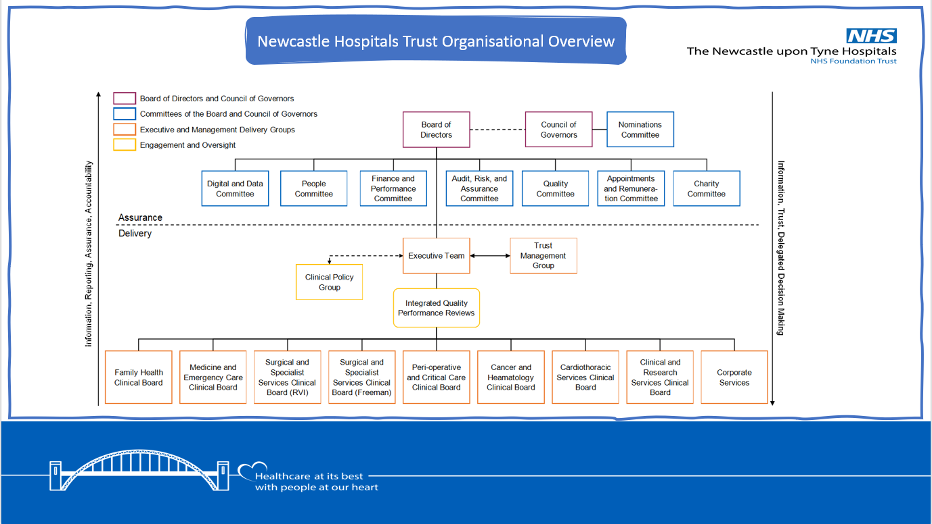
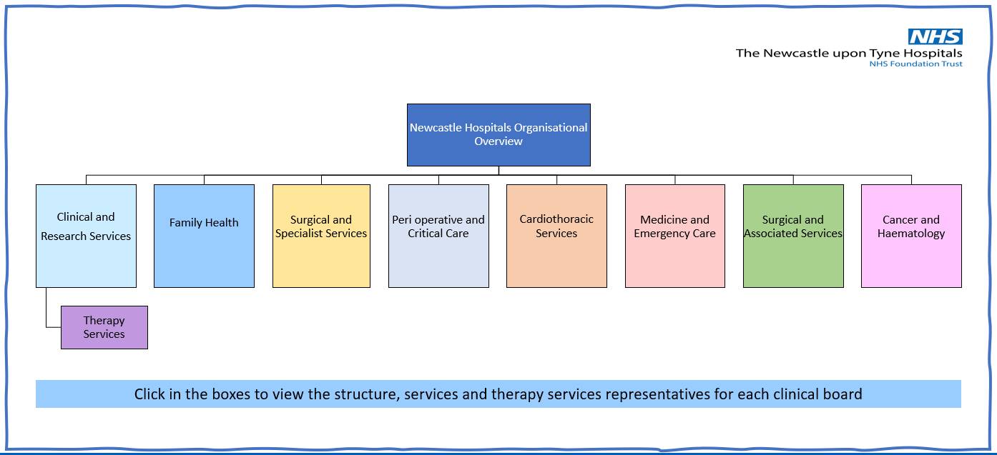
Strategy in Action Meeting Highlights (12.06.24)
Ewan Dick welcomed everyone to the June “Strategy in Action” meeting and opened by reflecting on the previous meeting where we discussed how Therapy Services, as a standalone Directorate, have services which align to and influence patient care across all aspects of the new clinical board structure. The slide deck developed for Therapy Services staff will continue to evolve but illustrates the management structure of all of the Clinical Boards and the work we are doing through the Therapy Services development groups to build strong links and working relationships.
We have also included a Newcastle Hospitals Trust Organisational structure, how governance, assurance and accountability is provided, showing the connection between the Trust executive, through Clinical Boards and to Directorate clinical and operational teams.
The ask from Ewan is for Heads of Services and Operational/Team Leads colleagues to discuss these slides at team meetings, to give the opportunity for staff to ask questions and share their thoughts and feedback. Any ideas on how we can improve these slides or ways in which we can help communicate with all of our staff would be very welcome – please send through to Laura Hodgson – laura.hodgson12@nhs.net.
In the next part of the meeting, Sam Browne, Advanced Practice Physiotherapist with TIMS joined to share the background work to his project on persistent pain and intersecting health inequalities and his research on Pain Science Education (PSE)PSE via an interpreter.

Slide 2
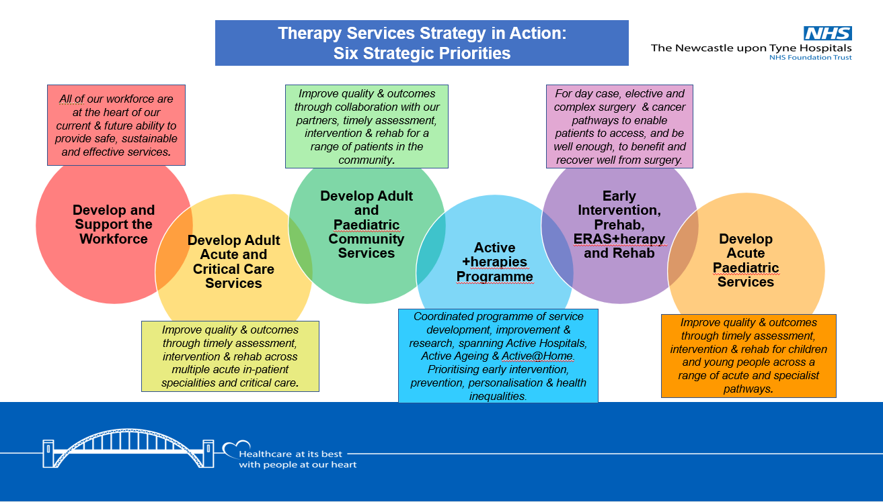
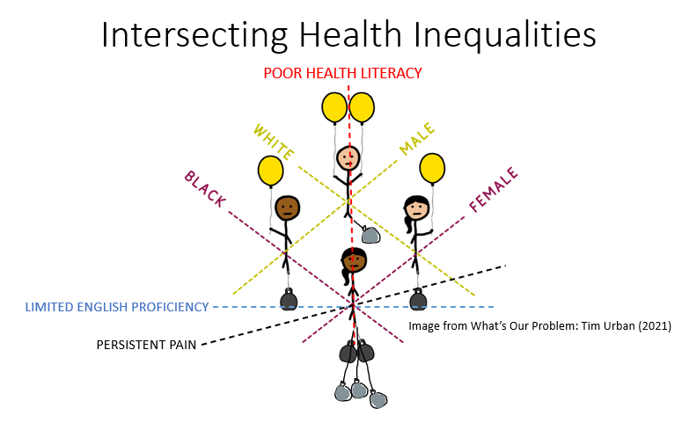
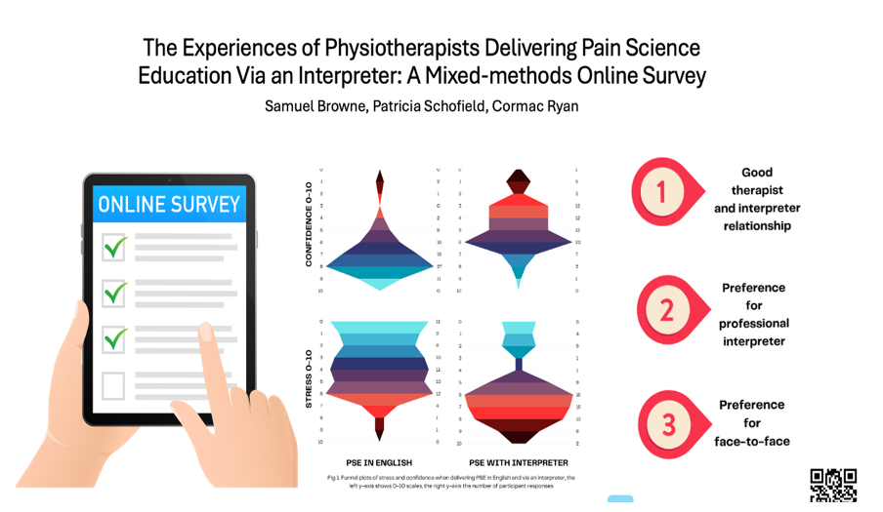
Strategy in Action Meeting Highlights (12.06.24)
Sam continued to explain, Pain Science Education (PSE) is a core component of contemporary pain management. It aims to improve an individual’s pain-related health literacy, their understanding of their condition and perception of the pain they are experiencing – and robust evidence has demonstrated that PSE can improve a person’s experience of pain.
Little is known about the patient experience and effectiveness of PSE within minority and disadvantaged groups, and/or when it is delivered via an interpreter. Poor pain literacy may be widening the inequalities gap and further work is needed to better understand this, and quantitative, qualitative, or mixed methods approaches might be employed to do so.
Sam was successfully awarded a NIHR Pre-doctoral Clinical Practitioner Fellowship (PCAF) and is now in his second year – Ewan added, “Sam is hugely passionate about this topic and his research will, for the first time explore some of these patients experiences, helping to understand how we might better provide information and advice to improve their care and experience”. Please click here to read Sam’s full presentation.
In the final part of the meeting, Ewan shared and reflected on the six Therapy Services strategic priorities we set out in 2023.
Ewan explained that strategy is only valuable if it’s meaningful, helps us set out what we would like achieve and ways in which we can work together to do things better. In light of organisational changes and new priorities, in the next Strategy in Action meetings we will be reflecting on where we have got to and how we might refresh some of our strategy priorities and to shape a plan over the coming months.
And in our next Strategy in Action Meeting……..
The next Therapy Services Strategy in Action Meeting will take place on Wednesday 10th July.
Please contact Tina Doyle if you would like to attend.

