Slide 1
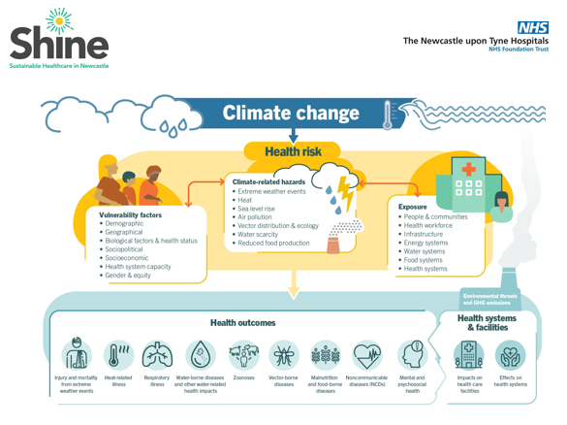
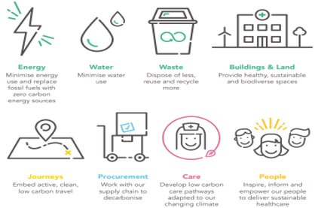
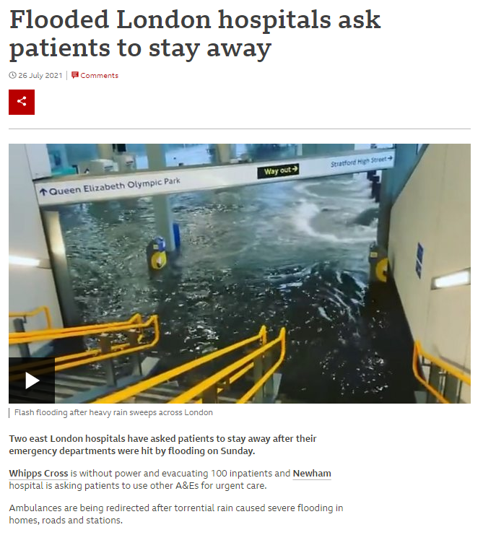
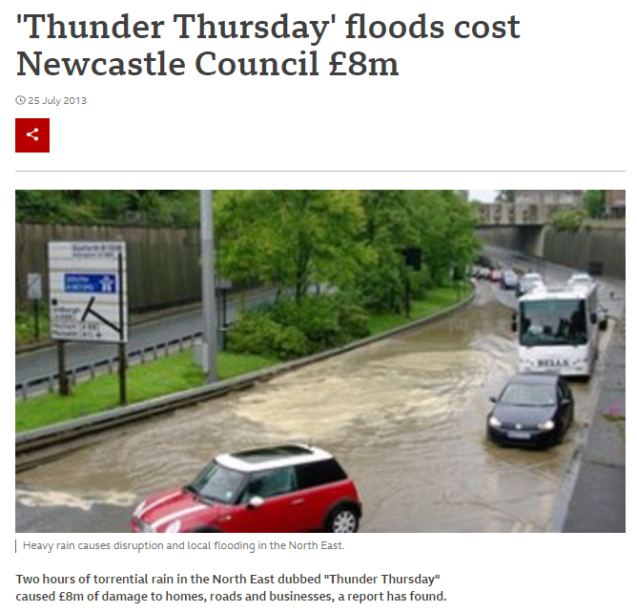
Strategy in Action Meeting Highlights (10.07.24)
Ewan Dick welcomed everyone to the July “Strategy in Action” meeting and opened by introducing Karen Taylor (Assistant Sustainability Manger) who had been invited along to this month’s meeting to provide a Trust Sustainability update.
Karen began her presentation by explaining the health risks and impacts on the delivery of patient care from climate change and then provided a reminder of the Trust Climate Emergency Strategy and vision to be a global leader in sustainable healthcare delivery and three goals of Net Zero, Clean Air and Zero Waste.
Useful Resources:
https://www.climatepsychologyalliance.org/
The discussion then went on to detail some of the work that is already happening to support the sustainability strategy such as the de-carbonisation of Regent Point, the planned exit from the CAV site and the Green the Grey nature trail at the Freeman. Karen added that there are so many ways to get involved from becoming a Green Champion and embedding sustainability as a regular agenda item team meetings to creating a 10 Step Sustainability framework.
Ewan also added that we need to consider how we work more effectively and build in environmental positives such as avoiding admissions, clinical interventions and increasing the use of PIFU to reduce unnecessary appointments.
James Callaghan, Head of Dietetics & Nutrition highlighted some of the work his team had been doing over the last year to generate a sustainability action plan. Ideas from the team included building a relationship with the Sustainability team, increasing awareness among the team through internal and external training and sharing success stories to inspire others. There was also discussion around how some project ideas were being shared and could benefit teams from other NHS Trusts.
We agreed that the Heads of Service to make a start on their sustainability journey by creating a plan, using the 10 Step Sustainability Framework and collectively aim over the next 6 months to increase awareness and understanding and embed sustainability as a principle.
https://www.climatepsychologyalliance.org/
NHS England » Where you can make a positive impact towards net zero
Home | Sustainable Quality Improvement (susqi.org)

Slide 2
Strategy in Action Meeting Highlights (10.07.24)
The next part of the meeting focused on Active Hospitals and an update from Cath Turner and Kate Hallsworth.
Kate explained that in the North-East, inactivity levels (people who do less than 30 mins activity over the course of the week) are higher than in the rest of England, with over a third of the Newcastle population being inactive.
Over 300 patients were screened for intervention from the youngest aged 21 to the oldest aged 93 and nearly 400 active conversations and 1800 activity-based interventions were completed. The next challenge is to map out where patients go next – mapping out the links between hospital and community.
What’s next?
Building further connections
Embedding a meaningful offer for patients
Physical activity calculator on eRecord
Running a workshop to develop a Physical Champion network to collaborate and moving initiatives forward together.
The Active Hospitals project was a 23 month pilot funded by Newcastle Hospital Charity with the aim of:
Supporting patients with long term conditions to become more physically active on the wards
Supporting patients to become more active on discharge
Increasing awareness amongst staff through courses such as Physical activity and clinical champion training (PACC), Health Coaching and re-introducing Make every contact count (MECC).
Turning attention to the recent event organised by Cath and Kate on the 4th July “Embedding Physical Activity in Healthcare across NUTH”, Ewan commented that the purpose of the event was to bring together colleagues across acute, community, adults and paeds to understand and discuss issues and advocate broader aspects of physical activity and how we can influence it.
Cath and Kate added that there’s a huge gap between the push to get people out of hospital quicker its fundamental that we build a network of people who are advocates and resources to support the delivery of interventions in different settings.
Ewan concluded this part of this discussion and led into the final part of the meeting where the focus turned to how we might like to develop, re-shape and re-focus our strategic priorities.
Work started with patients on Ward 16 at the Freeman and with staff, senior management and community partners and strong relationships have been developed with social prescribing link workers to develop a menu of options for patients; a ward-based resource pack, signposting resource pack & follow up phone calls.

Slide 3
Strategy in Action Meeting Highlights (10.07.24)
Ewan shared a reminder of the current six strategic priorities and acknowledged in terms of organisational changes and developments, we might need to think differently about how we articulate these to link with what the Trust wants to achieve.
Ewan encouraged the opportunity to be ambitious with our plans and how our priorities might evolve - explore Movement for Change, a Rehab, Recovery & Reconditioning strategy, psychology in healthcare, sustainability, gaps in specialty services to reduce single points of failure, innovation and the key staff & workforce priority.
Discussion around developing our future themes and priorities will continue in future Strategy in Action meetings – any further thoughts or ideas from the group will be welcome.
In the final part of the meeting, there was an update from Karen Storey on the Communication and Engagement working group.
Karen explained that there has been a strong focus by the group on how we communicate through the completion of an email audit (looking at how many come from Therapies and duplication of information), identifying people in Therapies who don’t have regular access to email and training opportunities for email management.
Steph Graham is producing a process map for communications across Therapies and Laura Hodgson is continuing work on a Therapies organisation chart so everyone knows who is who. The group are also looking at the opportunity to develop a Therapies brand for emails and are exploring roadshows and learning and sharing events.
There is still the opportunity for people to be involved in the Communication and Engagement working group and anyone interested is encouraged to contact Karen Storey for more information.
And in our next Strategy in Action Meeting……..
The next Therapy Services Strategy in Action Meeting will take place on Wednesday 25th September 2024.
Please contact Tina Doyle if you would like to attend.

